Slide 1
Does Transit State of Good Repair Impact Highway System Reliability
M. Nazrul Islam
FTA, Office of Planning and Environment
June 03, 2019
17th Planning Application Conference
Portland, OR, June 03, 2019

Slide 2
Why this Study
MAP-21 requires transportation agencies to implement a performance based approach to transportation planning.
The MAP-21 performance measures include transportation system reliability, congestion, asset management and state of good repair, in addition to safety, environmental benefits and freight.
Does transit state of good repair impact transportation system reliability and congestion on the highway system and other modes?
The WMATA SafeTrack closures provided an opportunity to assess transportation system reliability and congestion during transit system changes.
Notes:
MAP-21 (Moving Ahead for Progress in 21st Century, Surface Transportation Bill, Signed by President Obama in July 6, 2012) requires implementation of performance based approach to transportation planning.
It includes transportation system reliability, congestion, asset management and state of good repair, in addition to safety, environmental benefits and freight.
Our goal is to evaluate - whether transit state of good repair impact transportation system reliability and congestion on the highway system and other modes?
The WMATA SafeTrack closures provided an opportunity to assess transportation system reliability and congestion during transit system changes.

Slide 3
SafeTrack Surge Dates and Locations
Surge # | Dates | # of Days | Lines | SingleTrack/ Shutdown | Locations
1 | Jun 4 - 16, 2016 | 13 days | Orange & Silver | Single Track | East Falls Church to Ballston
2 | Jun 18 - Jul 3, 2016 | 16 days | Orange, Blue & Silver | Segment Shutdown | Eastern Market to Minnesota Ave & Benning Road
3 | Jul 5 - 11, 2016 | 7 days | Yellow & Blue | Segment Shutdown | National Airport to Braddock Road
4 | Jul 12 - 18, 2016 | 7 days | Yellow & Blue | Segment Shutdown | Pentagon City to National Airport
5 | Jul 20 - 31, 2016 | 12 days | Orange & Silver | Single Track | East Falls Church to Ballston
6 | Aug 1 - 7, 2016 | 7 days | Red | Single Track | Takoma to Silver Spring
7 | Aug 9 - 21, 2016 | 13 days | Red | Single Track | Shady Grove to Twinbrook
8 | Aug 27 - Sep 11, 2016 | 16 days | Yellow & Blue | Single Track | Franconia-Springfield to Van Dorn Street
9 | Sep 15 - Oct 26, 2016 | 42 days | Orange | Single Track | Vienna to West Falls Church
10 | Oct 29 - Nov 22, 2016 | 25 days | Red | Segment Shutdown | Fort Totten to NoMa
11 | Nov 28 - Dec 20, 2016 | 23 days | Orange & Silver | Single Track | East Falls Church to West Falls Church
12 | Feb 11 - 28, 2017 | 18 days | Blue | Segment Shutdown | Rosslyn to Pentagon
13 | Mar 4 - Apr 12, 2017 | 40 days | Blue & Yellow | Single Track | Braddock Rd to Huntington/Van Dorn St
14 | Apr 15-May 14, 2017 | 30 days | Green | Segment Shutdown | Greenbelt to College Park/Prince George's Plaza
15 | May 16 - Jun 15, 2017 | 31 days | Orange | Segment Shutdown | New Carrollton to Stadium-Armory
16 | Jun 17 - 25, 2017 | 9 days | Red | Segment Shutdown | Shady Grove to Twinbrook
https://www.wmata.com/service/SafeTrack.cfm
Notes:
You might be wondering – why it is called SafeTrack?
SafeTrack is an accelerated track work plan to address safety recommendations; and rehabilitate the Metrorail system to improve safety and reliability. Through SafeTrack, Metro completes three years worth of work in one year. The plan significantly expanded repair time on weeknights, weekends and midday hours.
There were sixteen SafeTrack surges during the period from June 4, 2016 to June 25, 2017. Some of the surges were single tracking and some of them were complete shutdown of the segments. The surges varied from 7 days to 42 days.
For example, Surge #1 as you can see here is a single tracking from EFC to Ballston, started on June 4 and ended on June 16 of 2016; for 13 days. It affected Orange and Silver lines.
Similarly, surge #2 is for 16 days from June 18 to July 3^{rd.} It is a segment shutdown from Eastern Market to Minnesota Ave and Benning Road. Orange, Blue and Silver lines are affected due to this shutdown.
This slide shows all the dates, line names and locations.

Slide 4
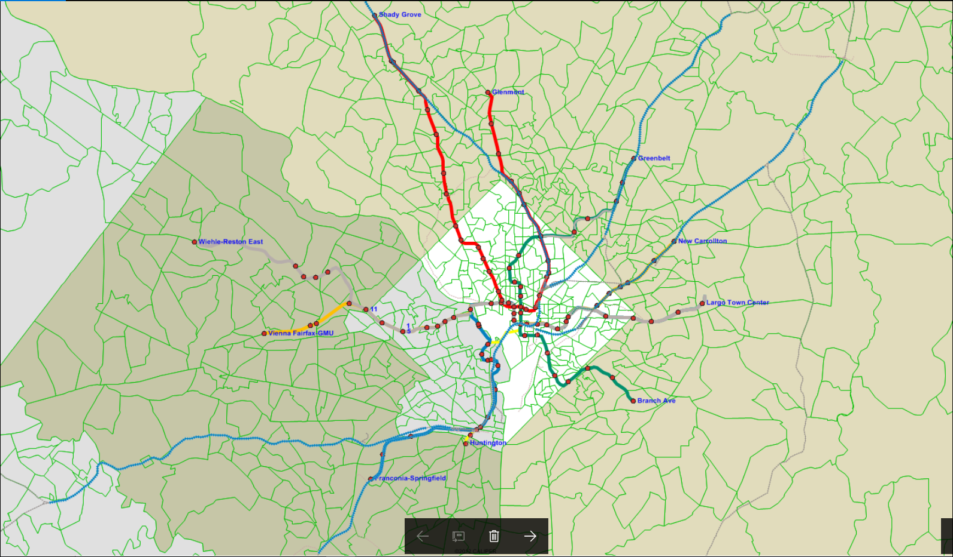
Metrorail System – SafeTrack Closure Locations
Segment Shutdown
Single Tracking
Notes:
This slide shows the locations of the closures in graphical format.
The RED Circles are SINGLE TRACKING locations, and
the GREEN Circles are SEGMENT SHUTDOWN locations
In the center you can see the District of Columbia
Left side is VA
Right and UP show MD
You can see MARC lines
VRE lines as well

Slide 5
Analysis Methodology
Obtain transit ridership, bike and pedestrian counts, auto counts and auto travel time for the same dates – 2015 (Base Year) and 2016 SafeTrack surge periods.
Compare the data to determine the level of increase/decrease from 2015 to 2016.
Average the changes across all SafeTrack surge days to identify consistent patterns.
Use Mid-Week (Tues-Thurs) data for all modes.
Notes:
First we identified the BASE PERIODs for the analysis.
Since this is a year-long process which includes 16 closures with various lengths; after going through the daily ridership numbers for the entire year, we decided that it would be better to compare the ridership numbers during the closures with the ridership number on one year prior days.
For example, the first SafeTrack Closures were in June 2016. For this closure, the BASE PERIOD is the same days in June 2015.
We received data for the entire SafeTrack closure periods and the BASE periods
We used three mid-week (Tuesday-Thursday) data for all the analyses. In the next slide, I will explain why we chose middle three days.
We averaged the changes across the SafeTrack Surge days.
We then compared the data to determine the level of increase/decrease from the Base to the Surge Periods.

Slide 6
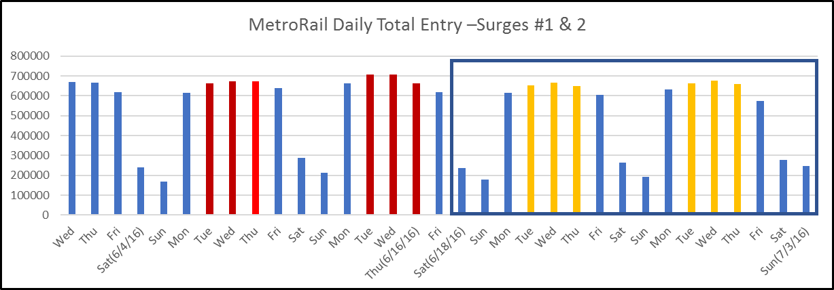
Data Analysis Days
Notes:
This slide shows the ridership #s in all seven days of the weeks for Surges #1 and #2
As shown in the figure, weekends riders are much lower than the weekday riders
and within the weekdays, Monday and Friday numbers are lower than the three days in the middle of the week. Middle three days’ ridership numbers are very much similar.
Surge #1 started on June 4 SATURDAY and ended on June 16, THURSDAY. We used ridership data for June 7-9 (Tuesday, Wednesday, and Thursday) and for June 14-16 (Tuesday, Wednesday, and Thursday), as shown in RED BARS.
Similarly, Surge #2 started on June 18 and ended on July 3rd. We used data for three middle days from two weeks, as shown here, in YELLOW BARS.

Slide 7
Data Sources
RAIL Ridership Data from
  WMATA (Washington Metro Area Transit Authority)
  VRE (Virginia Railway Express)
  MARC (Maryland Area Regional Commuter)
BUS Ridership Data
  WMATA
  Arlington Transit (ART)
  Alexandria (DASH)
  Fairfax Connector
Roadway Data
  Speed Data from FHWA NPMRD (National Performance Management Research Dataset)
  Virginia DOT Northern Region Operations - Traffic Count Data
  Maryland Highway AAWT (Annual Average Weekday Traffic) Data
Bicycle & Pedestrian Data
  Capital Bikeshare data
  Arlington County Bicycle & Pedestrian Data at River Crossings
Notes:
We contacted most of the transportation agencies in the Washington DC area and obtained data from them.
In terms of rail riders, we obtained data for Metrorail, VRE, MARC and also the METRO parking lot utilization data.
Regarding bus services, we obtained data for Metro Bus, Arlington Transit, Alexandria Transit, and Fairfax Connector.
We obtained roadway data from FHWA, Virginia DOT and Maryland DOT. FHWA provided speed/travel time data on river crossings between Virginia and Washington DC during the surges and BASE Periods.
Virginia DOT provided traffic count data at various locations for all the SURGE and BASE periods.
In terms of bicycle and pedestrian data, we downloaded Capital Bikeshare data from their websites. We also obtained bicycle and pedestrian counts data at four river crossings between Virginia and DC from the Arlington County transportation Office.
Northern Virginia Transportation Commission (NVTC) provided aggregate level data from all the agencies in Northern Virginia

Slide 8
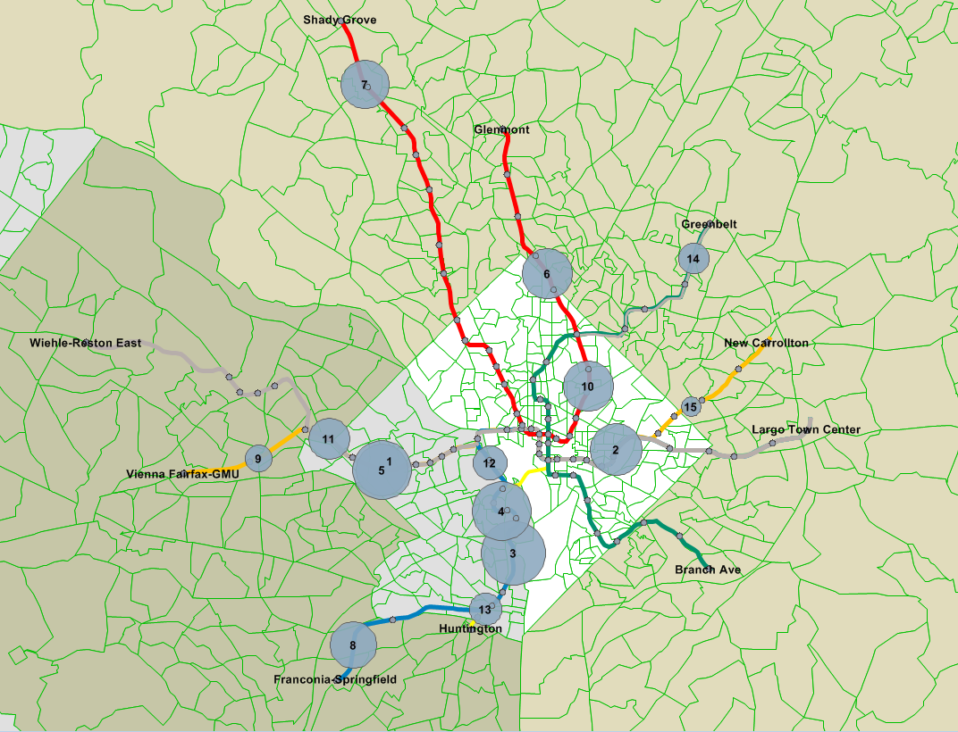
WMATA Metrorail Ridership Data
During the SafeTrack period and One-Year Prior
Notes:
This slide shows the daily Metrorail ridership #s during the BASE and SURGE periods for all the surges.
For example, Closure #1 which is between EFC and Ballston. In 2015 exactly one year prior to the SafeTrack Surge, the ridership was 766,306. The ridership number during the Surge Period was 681,845, which is 84,845 less than the Base number.
Similarly, Closure #4, between Pentagon City and National Airport. In 2015 one year prior to the SafeTrack Closure, the ridership number was 761,167. During the surges, the ridership went down by 109,858.
You can see here the reductions during all the closures
Surge #9 went down by 25,827
Surge #15 went down by 15,611
Average reductions of all the closure periods is 68,762.

Slide 9
Ridership Data – All Fifteen Surges
One-year Before and During the Surges
Notes:
In this slide you see the daily riders in LINE DIAGRAM.
X-AXIS in the map is the Surge numbers
Y-AXIS in the map is the daily boardings.
The ORANGE line shows the ridership numbers during the SURGES
The BLUE line shows the ridership numbers one year prior days; that means, BASE PERIODS.
As mentioned earlier, the average ridership reduction for all the surges is 68,762, with the maximum decrease of 124,156 at Surge #3 and minimum decrease of 15,611 at Surge #15.
You might notice here that the gap between the Orange and Blue lines are narrowing down as the Surge numbers are increasing.

Slide 10
Metrorail Riders Used Other Transit Modes
Notes:
Blue bars show the maximum changes in ridership and the Orange bars are the average changes.
For example, WMATA Shuttle ridership increased by 26,284 in one of the SafeTrack closer, but the average of all the closures are 7,504.
Alexandria bus and Fairfax connectors buses shows decrease in ridership during the closures. Most of the Alexandria and Fairfax connectors routes work as feeder routes to WMATA metro. As a result, with the decrease in metro Rail ridership, these two systems decrease ridership as well.

Slide 11
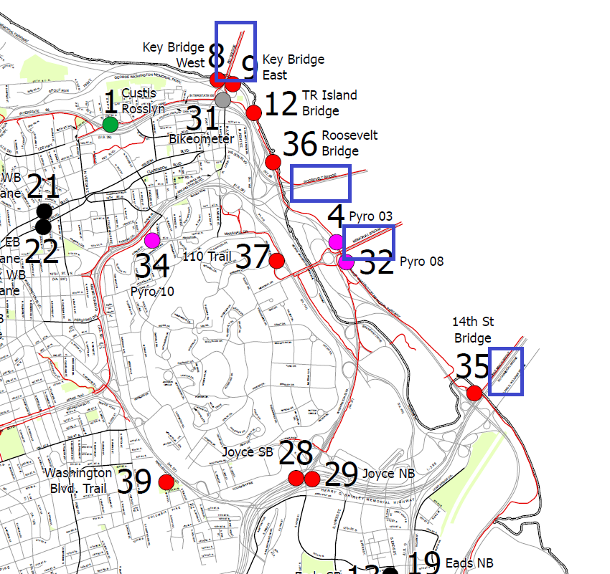
Arlington, VA – Bicycle & Pedestrian Count Locations
Legend
River Crossing Locations
Notes:
We also received Bicycle and Pedestrian crossing data from Arlington County.
This map shows the Arlington County, Virginia.
The BLUE boxes show the bridge locations.
Automatic pedestrian and bicycle counters are located at many locations including the following four bridge crossings, as shown in the map: The bridges are:
Key bridge
Roosevelt Bridge
Arlington Memorial Bridge
14th Street Bridge

Slide 12
Bicycle and Pedestrian Counts Increased
Notes:
We downloaded Capital Bikeshare data for all the days during the surges.
As mentioned earlier, we also obtained bicycle and pedestrian counts data on four river crossings from Virginia to Washington DC.
Northern Virginia Transportation Commission (NVTC) provided aggregate level data from all the agencies in Northern Virginia.
You can see here the Capital Bikeshare ridership went up during the closures.
The river crossing bikes and pedestrian also went up during the surges.

Slide 13
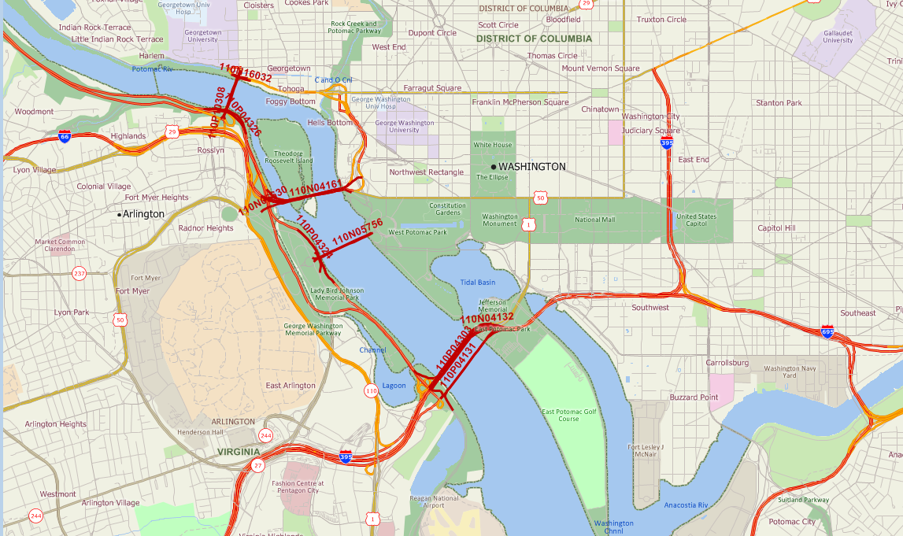
Roadway Speed Data from FHWA’s National Performance Management Research Dataset
Speed data at the following four Potomac Rider Crossings were obtained during the Surges and one-year before the Surges were compared:
Key Bridge
Roosevelt Bridge
Arlington memorial Bridge
14th Street bridge)
Notes:
We received speed data from FHWA’s National Performance Management Research Database for the BASE periods as well as for the Surge periods.
All the state DOT use the NPMR database for reliability and congestion related studies and work.
We analyzed speed data on the four bridges: They are:
Key bridge
Roosevelt Bridge
Arlington memorial Bridge
14th Street bridge
Those of you are not familiar with the area; these four-river crossings are the main connecting points between Virginia and Washington DC.
We analyzed speed data on these four bridges.

Slide 14
Average AM Peak Speeds Reduction
Notes:
This is the outcome of the speed data analysis.
As you can see here, the speeds during the Surges are lower than the BASE.
The average reduction is 2.1mph.
The maximum speed reduction is 5.2pmh during Surge #9
Speeds decreased for all the Surges except #10.
This is probably because of accidents or weather related impacts.

Slide 15
I-395 Directional AM & PM Speeds, During & Before the Surge
Notes:
We wanted to know the 24-hour speed distribution on a specific location and decided to use the I-395 speed data.
Figure shows NB and SB peak period speeds.
The RED lines are the speed during the Surges and DARK BLUE color line is the Base period speed.
Left graph shows PM Peak speed coming from DC. Right graph shows AM Peak speed going to DC.
Average speed during the Surges are consistently lower during the surges.
Impact on Peak periods are more than off-peaks

Slide 16
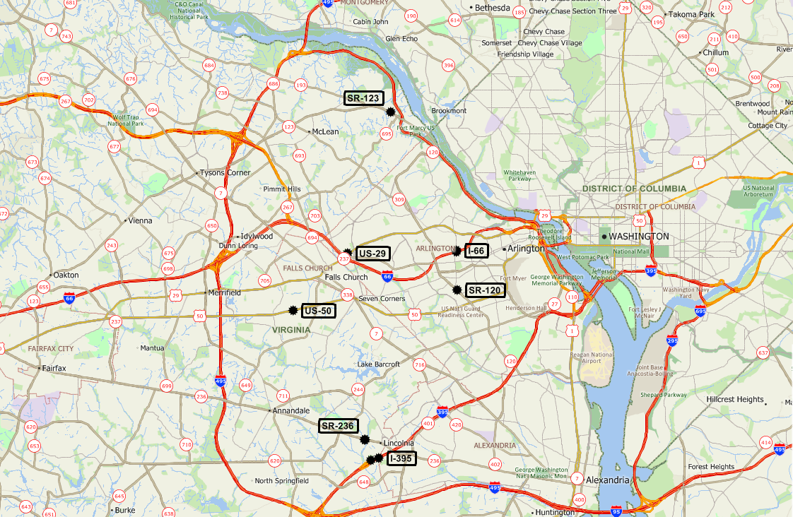
Traffic Count Locations:
1. I-66
2. I-395 & I-395 HOV
3. US 50
4. US 29
5. SR-236
6. SR 120
7. SR 123
Virginia DOT Roadway Traffic Count Data – Locations
Notes:
We obtained traffic count data from Virginia DOT
We could not find the traffic volume data on the four bridges mentioned earlier.
The locations shown in the map are the nearest locations we were able to receive traffic count data from VA DOT.
Locations are on I-66, I-395, US-50, US-29 and other roadways going to and from DC.
We received data for the Surge and Base periods.

Slide 17
Average of All Routes – Percent Increase from 2015 to 2016
Notes:
Weekday traffic volumes increase during the surges are shown here.
Percent traffic volume increase varies with a maximum increase of 7.5%
The average increase is 2.5%
Volume decreased during the Surge #10. This is probably due to accidents or weather-related impacts.

Slide 18
Surge #1 - I-395 (2015 and 2016) – Hourly Roadway Volumes
Notes:
This slide shows the traffic volumes over the 24 hour period.
Like speed data, we analyzed the traffic volume on I-395.
Red line shows one year before and blue line shows during the surges.
During peak period volumes are higher, but during off-peak they are very much the same.
Both traffic volumes and travel times were increased on the I-395 location.

Slide 19
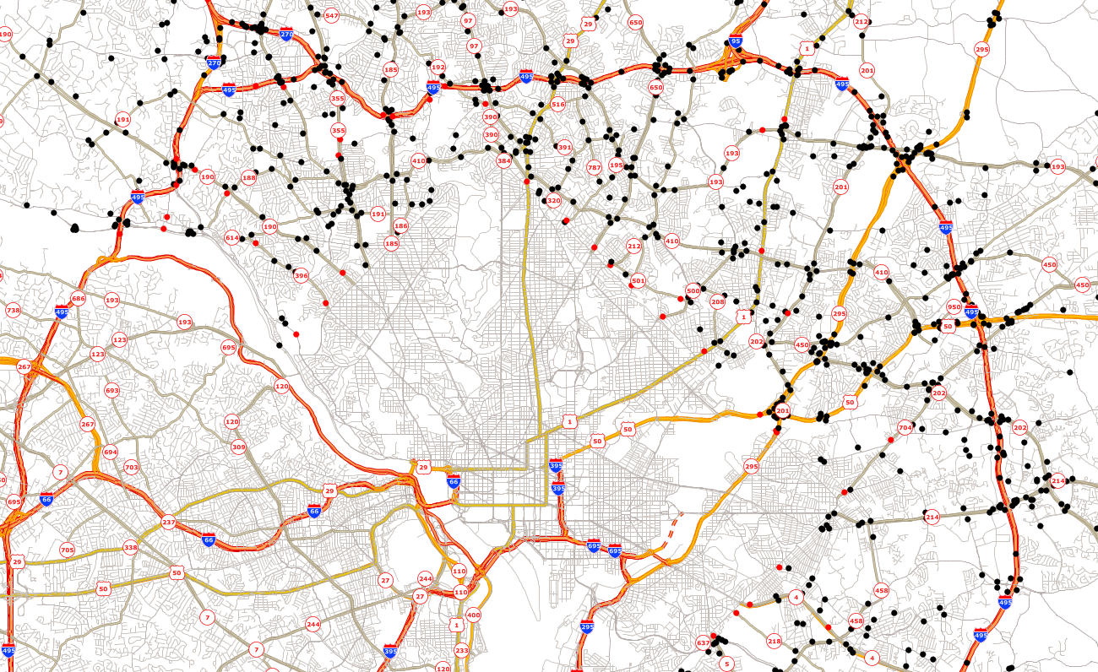
Traffic Count Locations in Maryland
Legend
Count Locations
Count Data Used
http://data.imap.maryland.gov/datasets/2b40c7c4367848218ce037a2a04b3c95_0
Notes:
We gathered Annual Average Weekday Traffic (AAWT) volumes on the Maryland Highways from their websites.
These are the count locations shown in the map.
We compared 2016 AAWT with the 2015 AAWT at the key locations.
We selected more than 50 locations entering towards DC from MD and summarized the volumes.
Those red dots are the locations we used the traffic counts.

Slide 20
Percent Maryland Highway Traffics Increase (To/From DC)
http://data.imap.maryland.gov/datasets/2b40c7c4367848218ce037a2a04b3c95_0
Notes:
Volume difference from 2015 to 2016 are shown by roadway types.
As you can see, almost all the roadway classes have increased traffic from 2015 to 2016.
Average increase is more than 2%.

Slide 21
The Metrorail Surges Impacted all Modes
Between Base and Surge:
Metrorail riders decreased (10%, 68,800)
Bus riders increased (1,100; Max 6,200)
Virginia Railway Express riders increased (1,350; Max 3,000)
Arlington Regional Transit riders increased (1,500; Max 2,900)
Fairfax connectors and DASH ridership decreased by 2,000 and 1,500 respectively
Pedestrian and bicycle counts increased (900)
Capital Bikeshare riders increased (950, Max 2,100)
MARC – Camden line riders increased (200)
Auto travel speed decreased (2.1pmh; Max 5.2 mph)
Traffic volumes on major Virginia roadways to/from DC increased (11,000)
Maryland roadways to/from DC increased (13,000)
Notes:
Let’s summarize the information we gathered so far
Because of the Safetrack Impact, the average Metrorail riders decrease is 68,800, which is about 10% of the total daily ridership
Average Metro bus riders on parallel routes are increased by 1,100
Arlington Transit ridership increased by 1,500
VRE riders increased by 1,350
Highway traffic volumes increased by 11,000 (in Virginia area).
Highway traffic volume increased by 13,000 in Maryland area
Capital Bikeshare increased by 950
Pedestrian and Bicycle in Arlington by 900
If we add these numbers, the total becomes about half of the 68,800
Out of 68,800 riders reduction on Metrorail, we know about half of them. So, what happened to the remaining half? Did they telework, carpooled, took some sort of leave of absence?
We don’t know
In the next couple of slides, we will show a route specific analysis

Slide 22
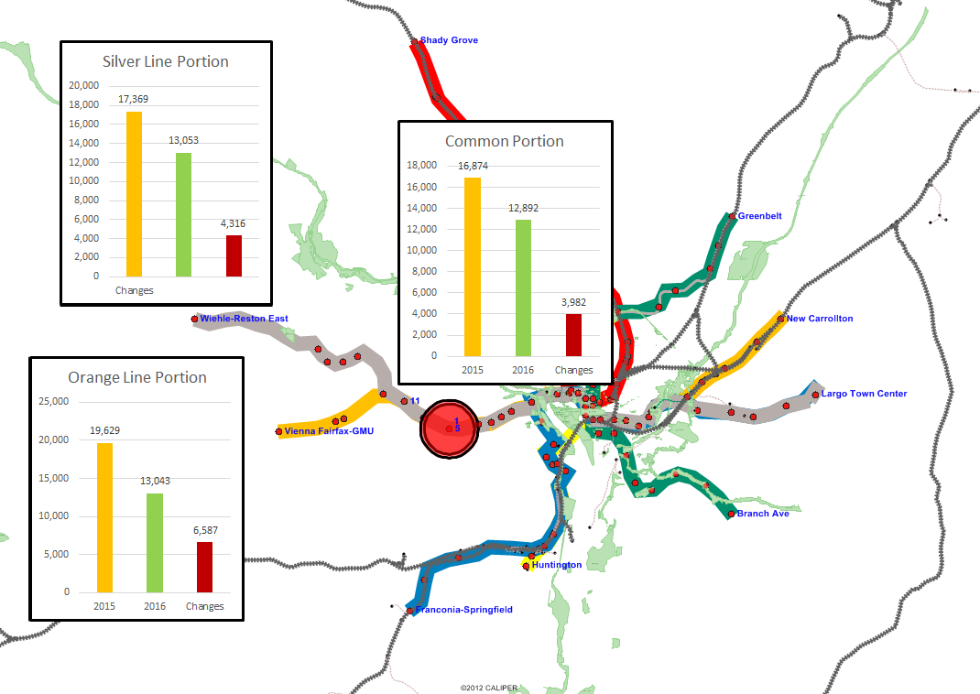
Surges 1&5 – Boardings During and One-Year Prior
Notes:
Surges #1 and #5 are in the same location between EFC and Ballston. This location is in western part of the system, in Virginia.
We wanted to evaluate the single tracking at this location more carefully.
Both Sliver line and Orange Line pass through this segment.
We divided Lines from Ballston to the end of the Silver and Orange lines into three segments.
Orange and Silver combined
Orange only portion
Silver only portion
Reductions in all three segments are proportionate. The yellow bar is the Base, Green bar is during the Surges and the RED bar is the delta between two periods.
There are three main parallel roadways to this segment. They are: I-66, US-50, and US-29.
We analyzed traffic conditions during these periods

Slide 23
Surges 1 & 5 - Roadway Volumes Change
 |  | I-66 Volume
 |  | Surge #1 | Surge #5
Daily Total | 2015 | 53,676 | 53,356
 | 2016 | 55,768 | 55, 969
 | Delta | 2,092 | 2,613
 |  | US 29 Volume
 |  | Surge #1 | Surge #5
Daily Total | 2015 | 12,803 | 12,368
 | 2016 | 13,024 | 12,637
 | Delta | 221 | 269
 |  | US 50 Volume
 |  | Surge #1 | Surge #5
Daily Total | 2015 | 27,996 | 28,217
 | 2016 | 27,793 | 27,837
 | Delta | (204) | (380)
Notes:
You can see here, the increase in I-66 East Bound is around 514; US-29 increase is about 204; US50 increase is 437
Total I would say about 2,000; considering I-66 HOV only traffic during the peak periods.

Slide 24
Surges 1 & 5 - Average of Surges 1&5 (All Modes)
Notes:
This slide shows the possible distribution of decreased riders from Metrorail to other modes.
About 9% utilized Metro Bus
About 5% used VRE
About 11% used Arlington Transit
About 6% walked or biked and crossed the rivers
About 15% switched to auto
About 53% unknown
As you can see, about half of the riders are not counted. The rest half is spread to other modes including VRE, Arlington transit, WMATA Bus, and parallel highways
When we analyzed the entire system, we also found that about 50% of the reduced riders are not accounted for.
So, in the systemwide analysis we know about the half of the metrorail reduced riders.
In the corridor specific analysis we also know about half of the reduced riders.
NOW THE QUESTION IS WHERE DID THE REMAINING HALF GO??
Did they telework?? Carpooled?? Took some sort of leave??
THIS IS THE BIG QUESTION and we don’t’ know the answer yet.

Slide 25
Are Metrorail Riders Returning?
One-year Prior, During, and One-year After the Surges
Notes:
We recently received Rail ridership data one year after the surges for the months up to February 2018.
We averaged the ridership data for one year after the surge #s 4 to 12.
It can be seen here that the ridership number are higher from 2016, but did not go back to the BASE level.

Slide 26
In Summary
Metrorail state of good repair improves system reliability and reduces congestion on the highway system.
During the surges, freeway vehicle counts increased and highway travel speed decreased.
Approximately half of the reduced Metrorail riders switched to auto, Metrobus, VRE, Arlington Transit, bike and pedestrian modes during the surges.
Notes:
Let’s summarize our analysis before we open for questions
Metrorail state of good repair improves system reliability and reduces congestion on the highway system.
During the surges, freeway vehicle counts increased and highway travel times decreased.
Approximately half of the reduced Metrorail riders switched to auto, Metrobus, VRE, Arlington Transit, bike and pedestrian modes during the surges.

Slide 27
